Slide 1
Reinforcement Learning in Recommender Systems
By Gherghe Ioana-Delia, Grigore Diana-Nicoleta, Pintilie Ioana, Vulpoiu Alexandru

Slide 2
Recommendations with Negative Feedback via Pairwise Deep Reinforcement Learning
ABSTRACT
In this paper, we propose a novel recommender system with the capability of continuously improving its strategies during the interactions with users. We model the sequential interactions between users and a recommender system as a Markov Decision Process (MDP) and leverage Reinforcement Learning (RL) to automatically learn the optimal strategies via recommending trial-and-error items and receiving reinforcements of these items from users’ feedback which can be both positive and negative.

Slide 3
INTRODUCTION
Efforts have been made on utilizing reinforcement learning for recommender systems. Some approaches included modeling the recommender system as a MDP process and estimating the transition probability and then the Q-value table. However, these methods may become inflexible with the increasing number of items for recommendations. Thus, we leverage Deep Q-Network (DQN), an (adapted) artificial neural network, as a non-linear approximator to estimate the action-value function in RL.
When we design recommender systems, positive feedback (clicked /ordered feedback) represents the users’ preference and thus is the most important information to make recommendations. In reality, users also skip some recommended items during the recommendation procedure so it is necessary to incorporate such negative feedback.

Slide 4
PROBLEM STATEMENT
The Markov Decision Process (MDP), consists of a tuple of five elements (S, A, P, R, γ ) as follows:
State space S: A state s_{t} ∈ S is defined as the browsing history of a user before time t. The items in s_{t} are sorted in chronological order.
Action space A: The action a_{t} ∈ A of RA is to recommend items to a user at time t. Without the loss of generality, we assume that the agent only recommends one item to the user each time.
Reward R: After the RA takes an action a_{t} at the state s_{t} , i.e., recommending an item to a user, the user browses this item and provides their feedback. They can skip (not click), click, or order this item, and the RA receives immediate reward r(s_{t}, a_{t} ) according to the user’s feedback.
Transition probability P: Transition probability p(s_{t+1} |s_{t} , a_{t} ) defines the probability of state transition from s_{t} to s_{t+1} when RA takes action a_{t} . We assume that the MDP satisfies p(s_{t+1} |s_{t} , a_{t} , ...,s₁, a₁) = p(s_{t+1} |s_{t} , a_{t} ).
Discount factor γ : γ ∈ [0, 1] defines the discount factor when we measure the present value of future reward. In particular, when γ=0, RA only considers the immediate reward. In other words, when γ=1, all future rewards can be counted fully into that of the current action.

Slide 5
THE PROPOSED DEERS FRAMEWORK
Although the positive items represent the key information about users’ preference, this system will not change its state or update its strategy when users skip the recommended items. Thus, the state should not only contain positive items that the user clicked or ordered, but also incorporate negative (skipped) items.
We define state and transition process as follows:
State s: s = (s₊ ,s₋) ∈ S is a state, where s₊ = {i₁, · · · ,i_{N} } is defined as the previous N items that a user clicked or ordered recently, and s₋ = {j₁, · · · , j_{N} } is the previous N items that the user skipped recently. The items in s₊ and s₋ are processed in chronological order.
Transition from s to s′ : When RA recommends item a at state s = (s₊,s₋) to a user, if users skip the recommended item, we keep s′₊ = s₊ and update s′₋ = {j₂, · · · , j_{N} , a}. If users click or order the recommended item, update s′₊ = {i₂, · · · ,i_{N} , a}, while keeping s′₋ = s₋. Then set s′ = (s′₊ ,s′₋).

Slide 6
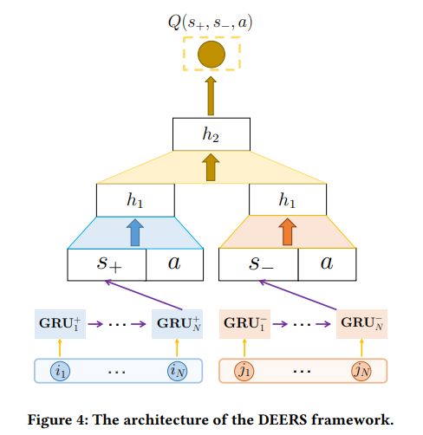
Figure 4 illustrates our new DQN architecture. Instead of just concatenating clicked/ordered/skipped items, we introduce a RNN with Gated Recurrent Units (GRU) to capture users’ sequential preference.
The inputs of GRU are the embeddings of user’s recently clicked /ordered items {i₁, · · · ,i_{N}}, while we use the output (final hidden state h_{N} ) as the representation of the positive state, i.e., s₊ = h_{N} . We obtain negative state s₋ in a similar way. Here we leverage GRU rather than Long Short-Term Memory (LSTM) because that GRU outperforms LSTM for capturing users’ sequential behaviors in recommendation tasks.
As shown in Figure 4, we feed positive input (positive signals) and negative input (negative signals) separately in the input layer. Also, different from traditional fully connected layers, we separate the first few hidden layers for positive input and negative input. The intuition behind this architecture is to recommend an item that is similar to the clicked/ordered items (left part), while dissimilar to the skipped items (right part).

Slide 7
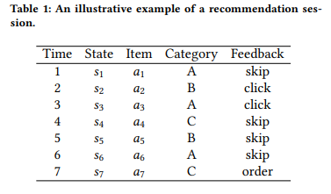
The Pairwise Regularization Term
With deep investigations on the users’ logs, we found that in most recommendation sessions, the RA recommends some items belonging to the same category (e.g. telephone), while users click/order a part of them and skip others. We illustrate a real example of a recommendation session in Table 1.
At time 2, we name a₅ as the competitor item of a₂. Sometimes, one item could have multiple “competitor” items; thus we select the item at the closest time as the “competitor” item.
We select one target item’s competitor item according to three requirements:
1) the “competitor” item belongs to the same category with the target item;
2) user gives different types of feedback to the “competitor” item and the target item;
3) the “competitor” item is at the closest time to the target item.
To maximize the difference of Q-values between target and competitor items, we add a regularization term α to the equation of the loss function.

Slide 8
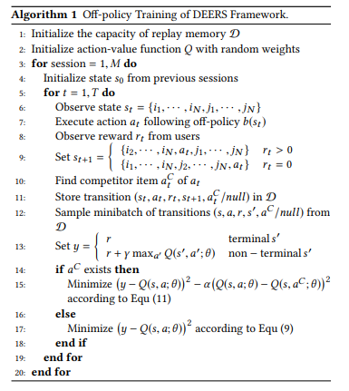
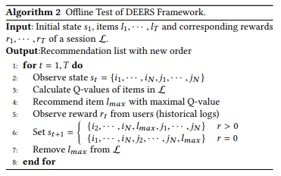
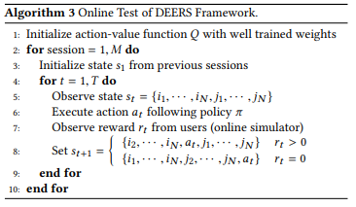
Off-policy Training Task
Offline Test
Online Test
We train the proposed model based on users’ offline log, which records the interaction history between RA’s policy b(s_{t}) and users’ feedback. RA takes the action based on the off-policy b(s_{t}) and obtains the feedback from the offline log (Algorithm 1).
The intuition of our offline test method is that, for a given recommendation session, the recommender agent reranks the items in this session according to the items’ Q-value calculated by the trained DQN, and recommends the item with maximal Q-value to the user (Algorithm 2).
The simulated online environment is also trained on users’ logs, but not on the same data for training the DEERS framework. We test the simulator on users’ logs and experimental results demonstrate that the simulated online environment has overall 90% precision for immediate feedback prediction tasks (Algorithm 3).

Slide 9
EXPERIMENTS
We evaluate our method on a dataset of September, 2017 from JD.com. We collect 1,000,000 recommendation sessions (9,136,976 items) in temporal order, and use the first 70% as the training set and the other 30% as test set. For a given session, the initial state is collected from the previous sessions of the user. In this paper, we leverage N = 10 previously clicked/ordered items as positive state and N = 10 previously skipped items as negative state. The reward r of skipped/clicked/ordered items are empirically set as 0, 1, and 5, respectively. The dimension of the embedding of items is 50, and we set the discounted factor γ = 0.95. For the parameters of the proposed framework such as α and γ , we select them via cross-validation. Correspondingly, we also do parameter-tuning for baselines for a fair comparison. We will discuss more details about parameter selection for the proposed framework in the following subsections.
For the architecture of Deep Q-network, we leverage a 5-layer neural network, in which the first 3 layers are separated for positive and negative signals, and the last 2 layers connect both positive and negative signals, and outputs the Q-value of a given state and action.
As we consider our offline test task as a reranking task, we select MAP and NDCG@40 as the metrics to evaluate the performance.

Slide 10
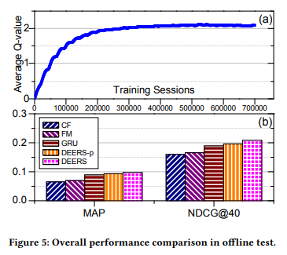
Performance Comparison for Offline Test
We compare the proposed framework with the following representative baseline methods:
CF: Collaborative filtering - making automatic predictions about the interests of a user by collecting preference information from many users
FM: Factorization Machines combine the advantages of support vector machines with factorization models.
GRU: This baseline utilizes the Gated Recurrent Units (GRU). To make comparison fair, it also keeps previous N = 10 clicked/ordered items as states.
DEERS-p: We use a Deep Q-network only with positive feedback (clicked/ordered items).
The results are shown in Figure 5
To sum up, we can draw answers to two questions:
(1) the proposed framework outperforms representative baselines;
(2) negative feedback can help the recommendation performance.

Slide 11
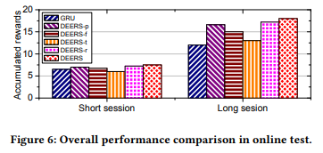
Performance Comparison for Online Test
We do online tests on the aforementioned simulated online environment, and compare DEERS with GRU and several variants of DEERS. Note that we do not include CF and FM baselines as offline tests since CF and FM are not applicable to the simulated online environment.
GRU: The same GRU as in the above subsection.
DEERS-p: The same DEERS-p as in the above subsection.
DEERS-f: This variant is a traditional 5-layer DQN where all layers are fully connected. Note that the state is also captured by GRU.
DEERS-t: In this variant, we remove GRU units and just concatenate the previous N = 10 clicked/ordered items as positive state and previous N = 10 skipped items as negative state.
DEERS-r: This variant is to evaluate the performance of the pairwise regularization term, so we set α = 0 to eliminate the pairwise regularization term.
As the test stage is based on the simulator, we can artificially control the length of recommendation sessions to study the performance in short and long sessions. We define short sessions with 100 recommended items, while long sessions with 300 recommended items. The results are shown in Figure 6.
In summary, appropriately redesigning DQN architecture to incorporate negative feedback, leveraging GRU to capture users’ dynamic preference and introducing the pairwise regularization term can boost the recommendation performance.

Slide 12
Reinforcement learning to rank in e-commerce search engine: Formalization, analysis, and application
ABSTRACT
Ranking items in a search is a multi-step decision-making problem that usually requires Learning to Rank (LTR) methods. LTR methods assume that steps in a session are independent, when in reality they can be highly correlated. In order to use the way in which steps relate to each other, the paper uses RL to learn an optimal ranking policy that maximizes the expected accumulative rewards in a search session.

Slide 13
INTRODUCTION
Search session between the user and the search engine is a multi-step ranking problem with the following steps
user inputs a query in the blank
search engine ranks the related items and displays the top K items
user makes operations (clicks, buys, requests a new page of the query aka view more)
when a new page is requested, the engine reranks the rest of the items and displays top k
All the steps repeat until the user buys items/leaves the search session (usually multiple rounds of this process)
This method
Considers a multi-step sequential ranking problem and proposes a new RL algorithm for learning an optimal ranking policy. The contributions are:
definition of search session Markov Decision Process to formulate the problem by identifying the state space, reward function, state transition function
proof that maximizing accumulative rewards is necessary → different ranking steps in a session are tightly correlated, rather than independent
new algorithm → deterministic policy gradient with full backup estimation → fit for the problem of high reward variance and unbalanced reward distribution → hardly dealt with even in state of the art RL
empirical demonstration → algorithm performs much better than online LTR

Slide 14
PROBLEM FORMULATION
Search Session Modelling
Top-k list → for an item set, a ranking function and a positive integer k, the top list L_{k} is an ordered item list which contains the top K items when applying the ranking function f to the item set D
Item page → for each step t during a session, the item page p_{t} is the top-K list resulted by applying the ranking action a_{t-1} of the search engine to the set of unranked items in the last decision step t-1. (initially, D₀ = D)
Item page history → in a search session, q is the input query. For the initial step, the initial item page history is q. For each later decision step, the item page history up to h is h_{t} = h_{t-1} and p_{t} where h_{t-1} is the page history up to the step t-1 and p_{t} is the item page of step t
Users may choose to purchase items or just leave at different steps of a session. If we treat all possible users as an environment which samples user behaviors, this would mean that after observing any item page history, the environment may terminate a search session with a certain probability of transaction conversion or abandonment.
Conversion probability → for any item page history in a search session h_{t}, B(h_{t}) is the conversion event that a user purchases an item after observing h_{t}. The conversion probability of h_{t}, which is denoted by b(h_{t}) is the averaged probability that B(h_{t}) occurs when h_{t} takes place.

Slide 15
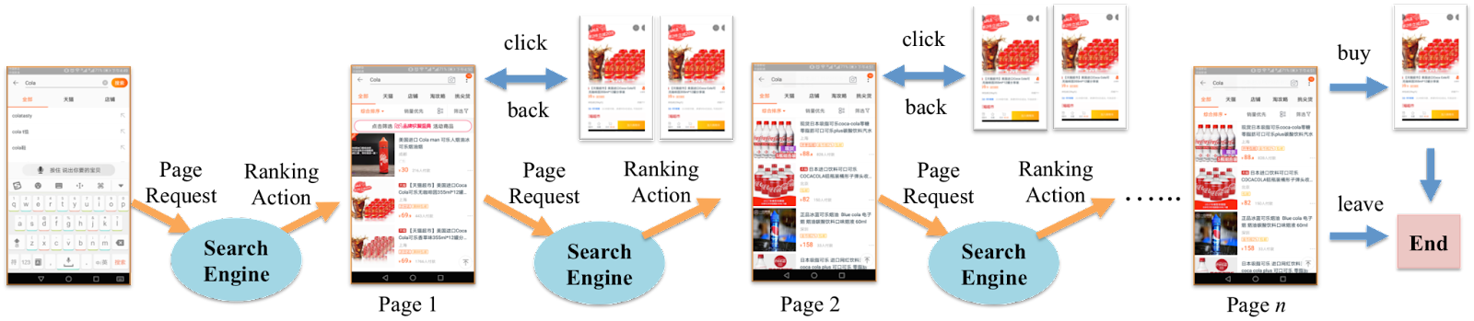
Abandon probability → for any item page history in a search session, L(h_{t}) is the abandon event that a user leaves the session after observing h_{t}. l(h_{t}) is the averaged probability that L(h_{t}) occurs when h_{t} takes place
Continuing probability → user continues searching after observing h_{t}.
These 2 types define how the state of the environment will change after a_{t-1} is taken in h_{t-1}:
terminating the search session by purchasing an item in h_{t} (probability b(h_{t}))
leaving the search session with probability l(h_{t})
continuing the search session from h_{t} with probability 1-b(h_{t})-l(h_{t})
Search Session MDP
Agent → search engine
Environment → Population of all possible users
States of the environment → indication of user status in the corresponding item page histories (continuation, abandonment, transaction conversion)
Action space → depending on the ranking task, can be continuous or discrete
Transition function → directly based on the conversion + abandonment probabilities
Reward function → highly depends on the goal of a task

Slide 16
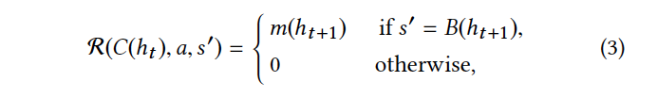
ANALYSIS OF SSMDP
Reward Function
Reward metric in online LTR → user clicks, but in E-commerce scenarios → successful transaction between users and sellers
This reward function → encourages more successful transactions
after observing the item page history, a user will purchase an item with a conversion probability and although different users may choose different items to buy, from a statistical view, the deal prices of the transactions occurring must follow an underlying distribution
for a history page, we use m(h_{t+1}) to denote the expected deal price of h_{t+1}
The agent will only receive a positive reward from the environment only when its ranking action leads to a successful transaction → otherwise, it is 0

Slide 17
ALGORITHM - policy gradient algorithm for learning an optimal ranking policy in a search session MDP (SSMDP)
policy gradient → directly optimizing a parameterized policy function addresses policy representation issue + large-scale action space issue
given a SSMDP, and a parameterized policy function, the objective of the agent is to find an optimal parameter for the said function which maximizes the expectation of the T-step returns along all the possible trajectories (trajectory = s₀, a₀, r₀, s₁, a₁, r₁, .., s_{T} and trajectory follows a distribution under the policy parameter)
if we reach a terminal state of the trajectory in less than T steps, the sum of the rewards will be truncated in that state
gradient leads to the REINFORCE algorithm and provides a framework which generalizes it
The DPG-FBE algorithm
we use the deterministic policy gradient algorithm (not stochastic) to learn an optimal ranking policy in an SSMDP because computing the stochastic policy gradient may require more samples
difficulty we face → estimating the value function, caused by the high variance (deal price varies over a wide range) and unbalanced distribution (the conversion events lead by (s, a) occur much less frequently than abandon and continuation which produce zero rewards) of the immediate rewards in each state (0 or the expected deal price)

Slide 18
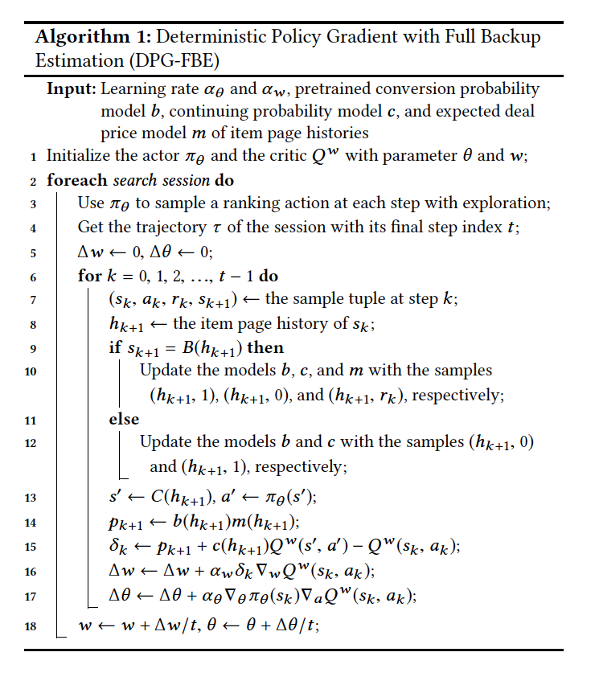
estimating the value function by Monte Carlo evaluation/temporal-difference learning → inaccurate update of the value function parameters
solution → similar to the model-based reinforcement learning approaches (they maintain an approximate model of the environment)
sampling errors caused by immediate rewards or returns are avoided and the computational cost of full backups is similar to that of one-step sample backups (like Q-learning)
algorithm is based on the deterministic policy gradient theorem and the full backup estimation of the Q-value functions
we don’t need to model the entire reward and state transition functions, we only need to build the conversion probability model, the continuing probability model and the expected deal price model (can be trained using online/offline data by any statistical learning method)
parameters θ and w will be updated after any search session
exploration (line 3) can be done by ε-greedy or adding random noise to the output of the parameterized policy function
we prefer nonlinear methods (neural networks) for learning the policy and value function due to the large space of an SSMDP → replay buffer + target updates also

Slide 19
EXPERIMENTS
a simulated experiment in which an online shopping simulator is constructed to test DPG-FBE and some other state-of-the-art LTR algorithms
a real application in which the algorithm is applied in TaoBao
Simulation
Statistical information of items and user behaviours is collected from TaoBao. An item is represented by an n-dimensional feature vector x and a ranking action of the search engine is a n-dimensional weight vector. The ranking score of the item is the inner product of the two vectors.
20 important features related to the item category dress (price, quality) are chosen and an item set is generated by sampling 1000 items from a distribution approximated with all the items of the dress category. Each page contains 10 items so that there are at most 100 ranking rounds in each search session.
In a ranking round, the user operations on the current item page (clicks/abandonment/purchase) are simulated by a user behaviour model.

Slide 20
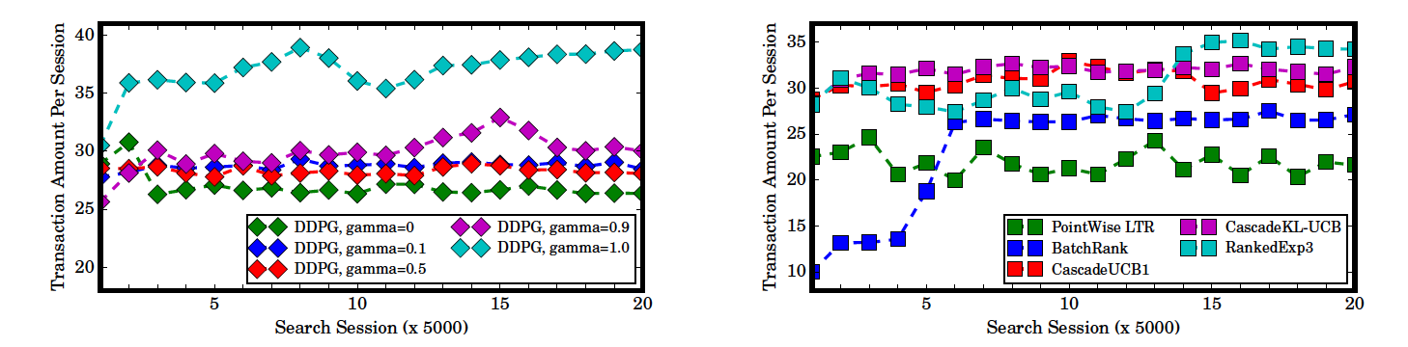
The simulator outputs the probability of each possible user operation given the recent item pages examined by the user. The search session ends when the user purchases one item or leaves.
The implementation of the algorithm is a deep reinforcement learning version which adopts neural networks as the policy and value function approximators. The state of environment is represented by a 180-dim feature vector extracted from the last 4 item pages in the current search session. (for more implementation details → see paper)

Slide 21
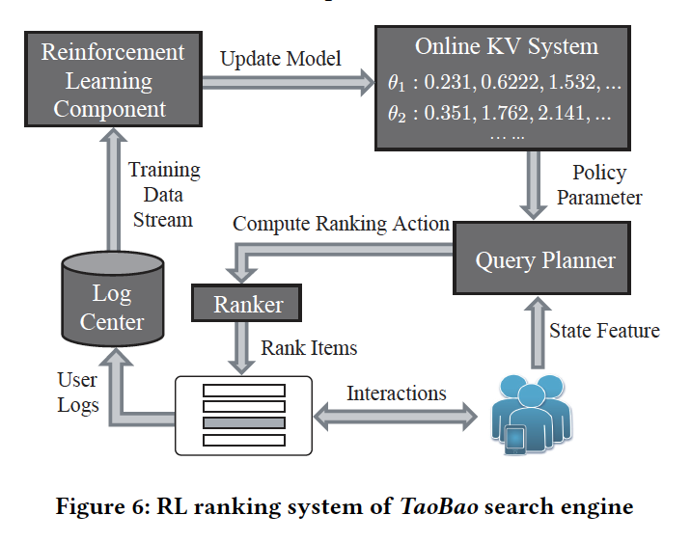
Application
The algorithm is used in the TaoBao search engine for providing online real time ranking service. The task is characterized by high concurrency and large data volumes. To deal with these issues, a data-stream driven ranking system is designed.
The workflow consists of 2 loops. The first one is an online acting loop in which the interactions between the search engine and TaoBao users take place. Every time a user requests an item page, the query planner will extract the state feature, get the parameters of the ranking policy model from the online KV system, and compute a ranking action for the current state. The ranker will apply the computed action to the unranked items and display the top K items in an item page, where the user will give feedback.
The second one is a learning loop where the training process happens. The two loops are connected through the log center and the online KV system used for collecting user logs and storing the ranking policy model.
The log data produced in the online acting loop is injected into the learning loop for constructing training data source. In the log center, the user logs collected from different search sessions are transformed to training samples like (s, a, r , s′), which are output continuously in the form of a data stream and utilized by the algorithm to update the policy parameters. Whenever the policy model is updated, it will be rewritten to the online KV system. The two working loops work in parallel but asynchronously, because the user log data generated in any search session cannot be utilized immediately.

Slide 22
A Deep Reinforcement Learning Framework for News Recommendation
ABSTRACT
Personalized news recommendation is a tricky problem, due to dynamic news features and user preferences. There are some news recommendation systems, but they have three major issues:
they only try to model current reward (e.g.: click through rate);
very few studies consider to use user feedback, other than click/no click labels (e.g.: how frequent user returns);
the existing methods often recommend similar news to users and it causes the users to get bored.
In this presentation, we will study a recommendation framework based on Deep Q-Learning, which can model future reward. To improve this system, user return pattern will be considered in addition to click/ no click labels.

Slide 23
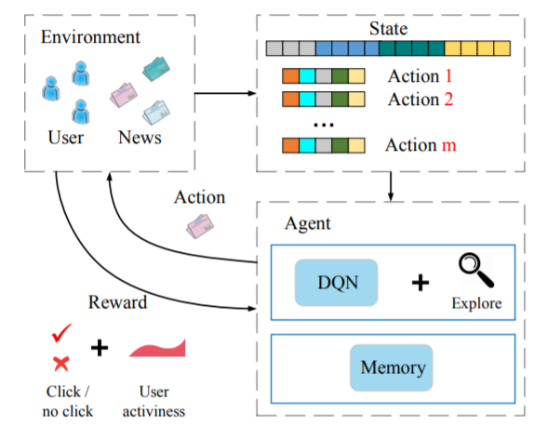
INTRODUCTION
In this paper, it’s described a Deep Reinforcement Learning framework, whose purpose is to solve the three challenges presented before:
for the first issue, Deep Q-Learning (DQN) framework is proposed, because it can consider current reward and future reward simultaneously;
for the second problem, user returning is considered as another form of user feedback, by maintaining an activeness score for each user;
for the third challenge, Dueling Bandit Gradient Descent (DBGD) method is used for exploration, by choosing random item candidates in the neighborhood of the current recommender and it ensures that no unrelated items will be recommended.
The next figure describes the recommendation system proposed:

Slide 24
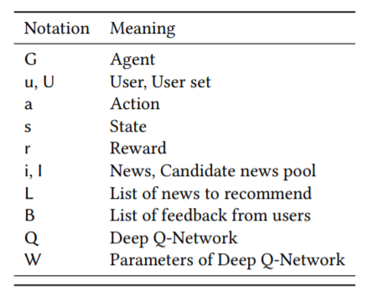
PROBLEM DEFINITION
When a user u sends a news request to the recommendation agent G at time t, given a candidate set I of news, our algorithm is going to select a list L of top-k appropriate news for this user. The notations used in this paper are summarized in the next table:
METHOD
To create a strong online personalized news recommendation system, we will study a solution that proposes a DQN-based Deep Reinforcement Learning framework. We will use a continuous state feature representation of users and continuous action feature representation of items as the input to a multi-layer Deep Q-Network to predict the potential reward. Due to the online update of DQN, this model can deal with the dynamic nature of news recommendation. DQN can also speculate future interaction between user and news. The model will combine user activeness and click labels as feedback from users.
For recommendation diversity, Dueling Bandit Gradient Descent (DBGD) method will be used.

Slide 25
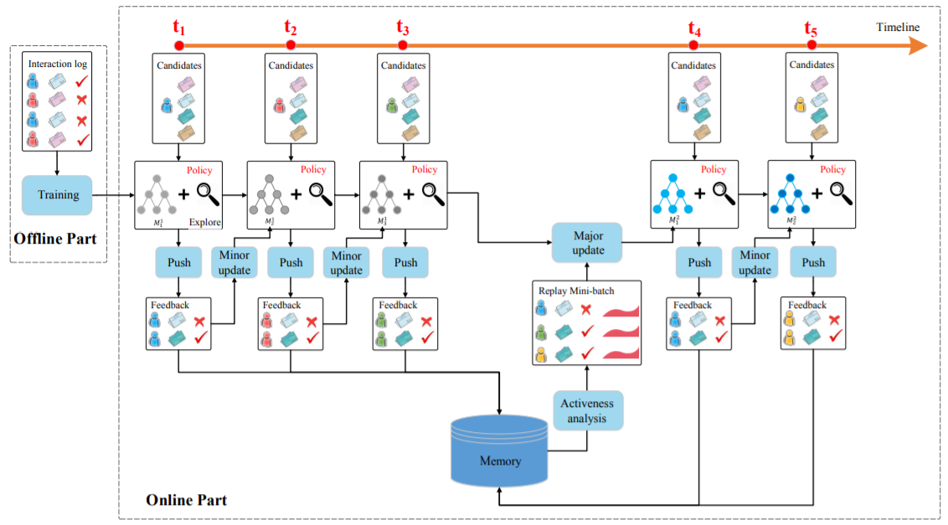
The figure above represents the model used for the news recommendation system and it contains two stages: offline and online.
The offline part consists of extracting four kinds of features from news and users:
news features
user features
user news features
context features
A multi-layer Deep Q-Network is used to predict the reward (a combination of user-news click label and user activeness) from these four kinds of features. This network is trained using the offline user-news click logs.
During the online part, the recommendation agent G interacts with users and updates the network in the following way:
PUSH
FEEDBACK
MINOR UPDATE
MAJOR UPDATE
REPEAT STEPS 1-4.

Slide 26
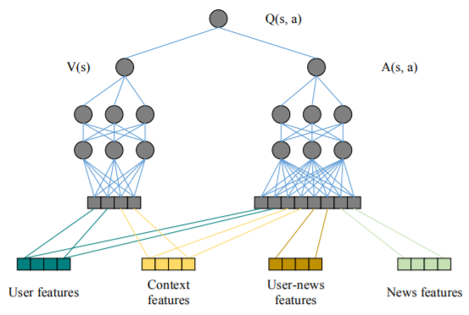
DEEP REINFORCEMENT RECOMMENDATION
As shown in this figure, we feed the four categories of features into the network. User features and Context features are used as state features, while User news features and Context features are used as action features. On one hand, the reward for taking action a at a certain state s is closely related to all the features. On the other hand, the reward that is determined by the characteristics of the user himself (e.g., whether this user is active, whether this user has read enough news today) is more impacted by the status of the user and the context only. Based on this observation, we divide the Q-function into value function V(s) and advantage function A(s, a), where V(s) is only determined by the state features, and A(s, a) is determined by both the state features and the action features.

Slide 27
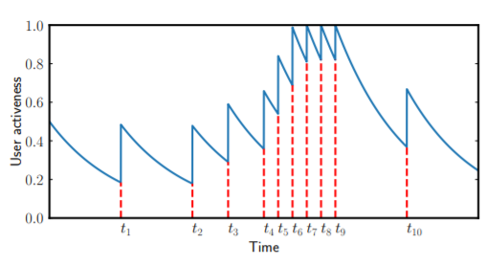
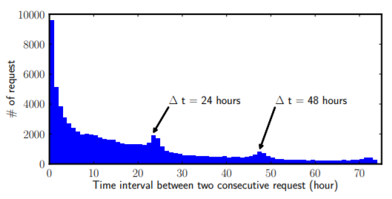
USER ACTIVENESS
Traditional recommender systems only focus on optimizing click through rate metrics, which doesn’t represent all the feedback a user can offer. A good recommendation might determine users to return to the application more often, so user activeness should also be considered properly.
For instance, as shown in this figure, user activeness for this specific user starts to decay from S₀ at time 0. At timestamp t1, the user returns and this results in a S_{a} increase in the user activeness. Then, the user activeness continues to decay after t1. Similar things happen at t2, t3, t4 and t5. Note that, although this user has a relatively high request frequency during t4 to t9, the maximum user activeness is truncated to 1.
The parameters S₀, S_{a}, λ₀, T₀ are determined according to the real user pattern in our dataset. S₀ is set to 0.5 to represent the random initial state of a user (i.e., he or she can be either active or inactive). We can observe the histogram of the time interval between every two consecutive requests of users as shown in the left figure.

Slide 28
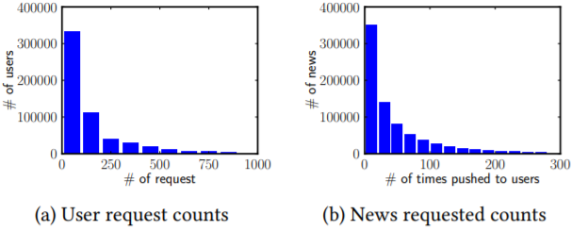
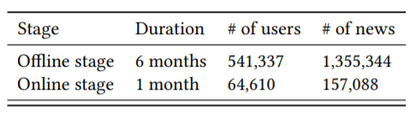
EXPERIMENT
DATASET
The experiment is conducted on a sampled offline dataset collected from a commercial news recommendation application and the system is deployed online to the App for one month. Each recommendation algorithm will give out its recommendation when a news request arrives and user feedback will be recorded (click or not). In this table, we can see the basic statistics for the sampled data:
In the first offline stage, the training data and testing data are separated by time order (the last two weeks are used as testing data), to enable the online models to learn the sequential information between different sessions better.
During the second online deploying stage, we use the offline data to pre-train the model, and run all the compared methods in the real production environment.

Slide 29
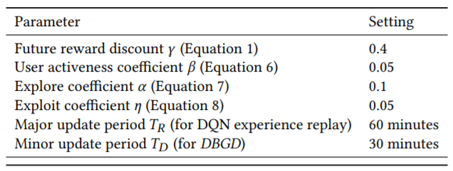
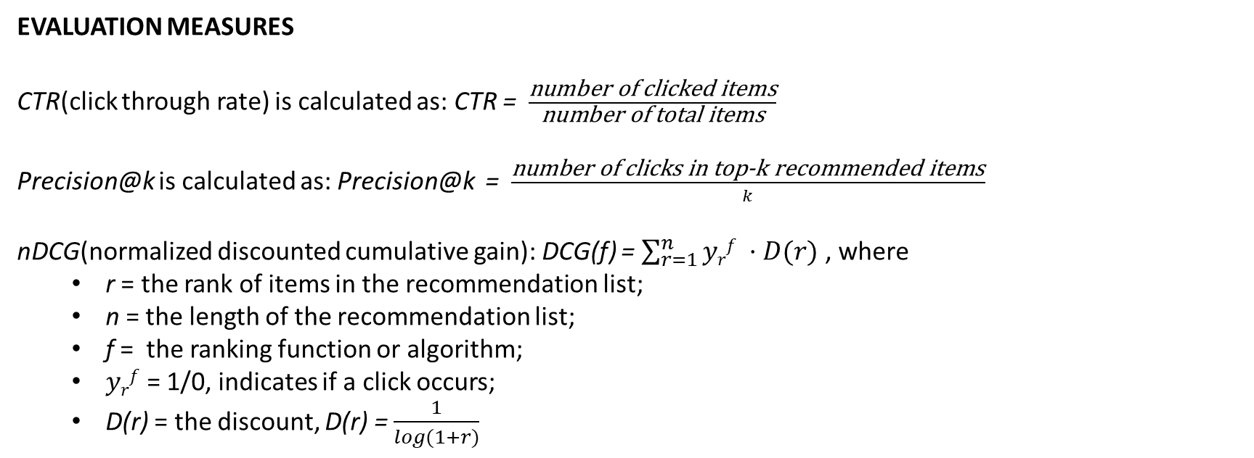
EVALUATION MEASURES
CTR(click through rate) is calculated as: CTR = $\frac{\text{number} \text{of} \text{clicked} \text{items}}{\text{number} \text{of} \text{total} \text{items}}$
Precision@k is calculated as: Precision@k = $\frac{\text{number} \text{of} \text{clicks} \text{in} \text{top}\text{-}\text{k} \text{recommended} \text{items}}{k}$
nDCG(normalized discounted cumulative gain): DCG(f) = $\sum_{r=1}^{n}{yrf ·D(r)}$ , where
r = the rank of items in the recommendation list;
n = the length of the recommendation list;
f = the ranking function or algorithm;
$yrf$ = 1/0, indicates if a click occurs;
D(r) = the discount, D(r) = $\frac{1}{log⁡(1+r)}$
EXPERIMENT SETTING
For this experiment, best parameters are found using grid search, and their values are presented in the next table:

Slide 30
COMPARED METHODS
variations of the model described
the basic model is named DN and it uses a Double Deep Q-Network without future reward;
when future reward is used, the model is DDQN;
more components are to DDQN depending on what other algorithms/features are used:
U = user activeness;
EG = ε-greedy;
DBGD = dueling bandit gradient descent;
baseline algorithms: the models above are compared with the next five baseline methods, which will conduct online update during the testing stage:
LR(logistic regression)
FM(factorization machines)
W&D(wide and deep)
LinUCB(linear upper confidence bound)
HLinUCB(hidden linear upper confidence bound)
For all compared algorithms, the recommendation list is generated by selecting the items with top-k estimated potential reward (for LinUCB, HLinUCB and our methods) or probability of click (for LR, FM and W&D) of each item.

Slide 31
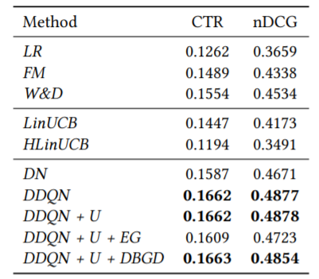
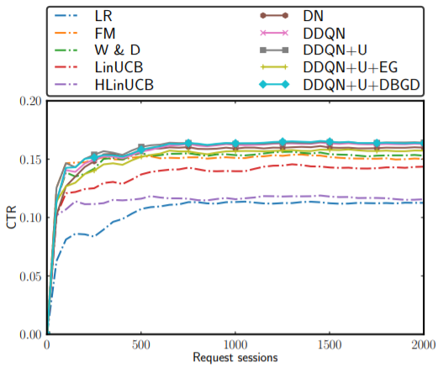
OFFLINE EVALUATION
In this stage, our models are compared with other baselines on the offline dataset. The offline dataset is static, so only certain pairs of user-news interaction have been recorded. We can’t observe the change of user activeness and the exploration strategy can’t explore well due to the limited candidate news set, so the efficiency of these methods isn’t visible in this situation.
accuracy
as expected, the models proposed outperform the baseline algorithms;
the accuracy is even better when future reward is added;
the results can be observed in the table;
model converge process
in order to study the convergence process, we will analyze the cumulative CTR of different methods in the graph on the right;
the offline data are ordered by time and simulate the process that users send news request as time goes by;
all the compared methods will update their models every 100 request sessions;

Slide 32
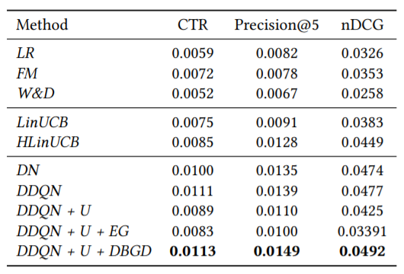
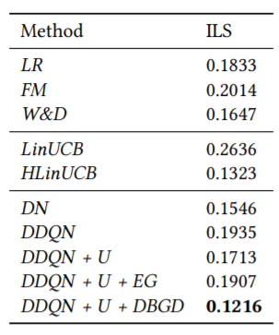
ONLINE EVALUATION
In the online evaluation stage, we deployed our models and compared algorithms on a commercial news recommendation application. Users are divided evenly to different algorithms. In online stage, we can’t only measure the accuracy of recommendation, but also observe the recommendation diversity for different algorithms.
accuracy
different algorithms are compared in terms of CTR, Precision@5 and nDCG;
the results are similar to those from offline stage, because the solutions
proposed in this article are better and the future reward considerations
represents an improvement;
recommendation diversity
in order to evaluate the effectiveness of exploration, we calculate the recommendation diversity of different algorithms using ILS
the diversity for the news clicked by users is represented in the right table;
smaller ILS indicates better diversity;
similarity between news is measured by the cosine similarity between the bag-of-words vectors of news;

Slide 33
Deep reinforcement learning for list-wise recommendations
ABSTRACT
The paper proposes a new recommender system with a more dynamic approach than the one used in traditional systems. The sequential interactions between the user and the system are modelled as a Markov Decision Process (MDP) and Reinforcement Learning (RL) is used by recommending trial-and-error items and leveraging the users’ feedback. An online user-agent interacting environment simulator is used to pre-train and evaluate the model offline. Moreover, the proposed framework LIRD develops a novel approach to incorporating list-wise recommendations.
INTRODUCTION
List-wise recommendations are more desired in practice since they allow the systems to provide diverse and complementary options to their users.
Existing approaches for list-wise recommendations do not take into account the relationship between the list items - for example, a news feed recommendation system might recommend a list of extremely similar news articles, when, in reality, a user might be more interested in being provided with diverse topics. The paper aims to enhance performance by capturing the relationship between the recommended items.

Slide 34
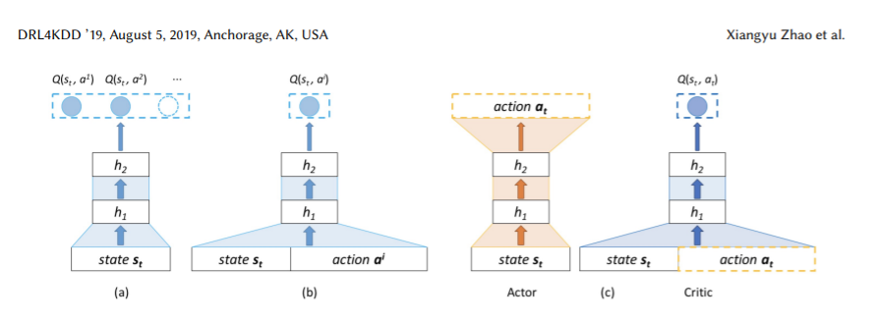
Architecture Selection
Generally, there exist two Deep Q-learning architectures, shown in Fig.1 (a)(b). The use of both poses issues when it comes to recommender systems, and the architecture shown in Fig.1(c) seeks to mitigate them.
Fig.1(a) depicts the architecture adopted by traditional deep Q-learning. It is suitable for the scenario with high state space and small action space, but not for the large and dynamic action space scenario.
Fig.1(b) depicts the second Q-learning architecture. Unlike the previous one, it is suitable for large action space, as it does not need to store each Q-value in memory. However, it does compute Q-values for all potential actions, which brings in the challenge of temporal complexity.
Fig.1(c) depicts the architecture upon which this paper’s recommending policy builds on. The Actor inputs the current state and aims to output the parameters of a state-specific scoring function. Then the RA (recommender agent) scores all items and selects an item with the highest score. Next, the Critic uses an approximation architecture to learn a value function (Q-value), which is a judgement of whether the selected action matches the current state. Finally, according to the judgement from the Critic, the Actor updates its policy parameters in a direction of recommending performance improvement. This architecture is both suitable for large action space and reduces redundant computations.

Slide 35
Online Environment Simulator
In order to tackle the challenging nature of training and evaluating the framework offline, the paper proposes an online environment simulator, which inputs current state and a selected action and outputs a simulated online reward. This enables the framework to train the parameters offline based on the simulated reward. More specifically, the simulator is built using users’ historical records - it is assumed that, no matter what algorithms a recommender system adopts, the user feedback to an item will remain unchanged.
Problem Statement
An RA interacts with the environment (or users) by sequentially choosing recommendation items over a sequence of time steps, so as to maximise its cumulative reward. We model the problem of listwise item recommendation as Markov Decision Process (MDP), which formally consists of a tuple of five elements (S, A, P, R,γ ).
State space S. A state s_{t} = {s_{t}¹ , · · · , s_{t}^{N}} ∈ S represents the browsing history of a user, i.e. the previous N items that a user browsed before time t. The items are sorted in chronological order.
Action space A. An action a_{t} = {a_{t}¹ , · · · , a_{t}^{K} } ∈ A is to recommend a list of items to a user at time t based on current state s_{t} , where K is the number of items the RA recommends to user each time.
Reward R. The RA takes an action a_{t} at the state s_{t} (= recommends a list of items to a user). The user can then skip, click, or order these items. Based on this feedback, the RA receives an immediate reward r(s_{t}, a_{t}).
P and γ have the usual MDP meanings

Slide 36
Instead of extra item information, in this paper, we use the user-agent interaction information, i.e., users’ browsing history. We treat each item as a word and the clicked items in one recommendation session as a sentence. Then, we can obtain dense and low-dimensional vector representations for items via word embedding.
The Actor Framework
Current practical recommender systems rely on a scoring or rating system averaged across all users, but this leads to poor results when there is high variation in users’ interests. To tackle this problem, a state-specific scoring function, which rates items according to the user's current state, is introduced.
In this section, we define the state s by taking into consideration only positive items, e.g. the previous 10 clicked/ordered items. This is more efficient than considering the entire browsing history, as a good recommender system should focus on user preferences.
The Critic Framework
The Critic is designed to leverage an approximator to learn an action-value function Q(s_{t} , a_{t}), which is a judgement of whether the action generated by the Actor matches the current state s_{t}. Then, according to Q(s_{t} , a_{t}), the Actor updates its parameters in a direction of improving performance.

Slide 37
The Training Procedure
In order to train the parameters of the proposed framework, DDPG (Deep Deterministic Policy Gradient - a model-free off-policy algorithm for learning continuous actions) is used.
In each iteration, we have the:
Transition generating stage: the RA recommends a list of items, observes the reward from the simulator, updates the state and stores the transition
Parameter updating stage: the RA samples mini-batches of transitions and the, following DDPG, updates the Actor’s and the Critic’s parameters.
The Testing Procedure
The testing procedure follows the same algorithm as the training procedure, meaning that the parameters continuously update while testing.
However, to make comparison between sessions possible, the parameters are set back to the well-trained ones Θ^{µ} and Θ^{π} after each recommendation session.

Slide 38
EXPERIMENTS
Experiments to evaluate the effectiveness of the proposed framework are conducted using a dataset from a real e-commerce site. The main focus points are: comparison to representative baselines, and analysis of how the list-wise strategy contributes to performance.
Experimental Settings
100,000 recommendation sessions (1,156,675 items) in temporal order were collected, the first 70% were used as the training set, and the remaining 30% as the testing set
The positive state is N = 10 previously clicked/ordered items.
Each time, the RA recommends a list of k = 4 items to users.
The reward r is set as 0, 1, or 5, corresponding to skipped/clicked/ordered, respectively
γ = 0.75, dimension of item embedding = 50
Parameter tuning for baselines is performed.

Slide 39
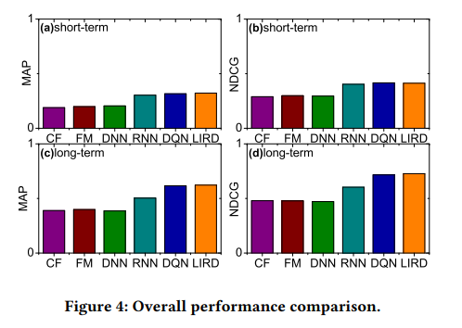
Performance Comparison for Item Recommendations
The proposed framework is compared to the following representative baseline methods:
CF (Collaborative filtering): a method that makes predictions about the interests of a user by collecting preference information from many users
FM (Factorization machines): combines the advantages of support vector machines with factorization models in order to model higher order interactions
DNN with backpropagation technique: trained to output the next recommended item, given the embeddings of users’ clicked/ordered items as input
RNN: also trained to predict what a user will buy next, based on previously clicked/ordered items
DQN: shares the same architecture as the Critic in the proposed framework
The performance is studied during short sessions (less than 50 recommended items) and long sessions (more than 50 recommended items).
To sum up the results, the proposed framework LIRD outperforms most representative baselines. Its performance is similar to DQON; however, LIRD is much faster to train, as it does not compute the Q-value for all potential actions, which makes it suitable in practice.

Slide 40
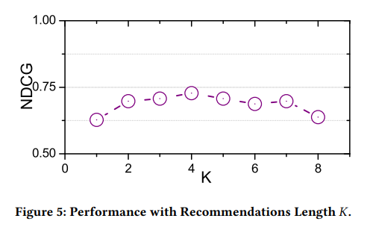
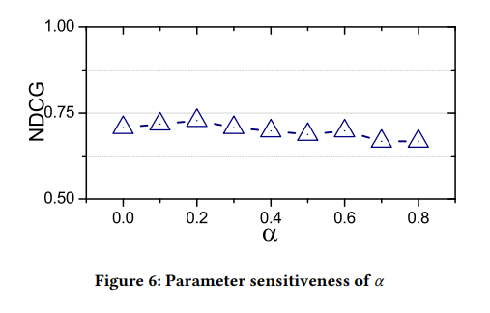
Performance of List-Wise Recommendations
In order to see how the listwise approach influences performance, we investigate how LIRD performs when the length K of the recommendation list is changed, while other parameters remain fixed.
Increasing the size of the recommendation list first increases performance, but is then followed by a decrease. The best results are achieved when K=4 - for smaller values, correlations between list items is lost, while larger values introduce noise.
To conclude, an appropriately chosen list length K can boost recommendation performance.
Performance of Simulator
The simulator’s key parameter is α - the trade-off between state and action similarity.
LIRD achieves the best performance when α = 0.2. In other words, when we map current state-action pair p_{t} (s_{t} , a_{t} ) to a reward, the action-similarity has a stronger contribution, while state-similarity influences the reward mapping process.

